Slide 1
CSE4421/5324: Introduction to Robotics

Slide 2
Contact Information
Burton Ma
Lassonde 2046
burton@cse.yorku.ca
CSE4421/5324
lectures Monday, Wednesday, Friday 2:30-3:30PM (ACW305)
labs Thursday 11:30-1:30, Prism 1006B
www.cse.yorku.ca/course/4421
(web site not complete yet)

Slide 3
Graduate Studies in Computer Science & Engineering
York University

Slide 4
Why a Master’s degree?
Job titles: Computer systems analyst, computer programmer, computer scientist, computer systems designer
Bachelor's degree salary: $50,985
Master's degree salary : $72,515
  Source: http://msn.careerbuilder.com/Article/MSN-1817-Salaries-and-Promotions-Bachelors-vs-Masters-How-Does-Your-Salary-Stack-Up/

Slide 5

But I can’t afford grad school …

Slide 6
We’ll pay you to study
$25,000 / year
Many will be awarded an entrance scholarship of $6,000 on top of the above $25,000.
Excellent applicants will be awarded an entrance scholarship of $10,000 on top of the above $25,000.

Slide 7
What will I do for my Master’s?
5 terms (20 months) of full-time study
Complete 5 courses (15 credits) with a GPA of at least B+
Complete a research project and write and successfully defend a thesis
Work as a TA (conducting labs/tutorials, marking, lab monitoring)
Have fun (ski trips, movie nights, foosball tournaments, Halloween/Christmas parties, conferences, etc.)

Slide 8
How good am I to be admitted?
An undergraduate honours degree in Computer Science or Computer Engineering
Minimum GPA of B+ in the last 2 years of study
Research aptitude (just as important as GPA)
The above requirements are minimum requirements and do not guarantee admission

Slide 9
Research Aptitude
Take project courses: CSE4080, CSE4081, CSE4082, CSE4083, CSE4084, CSE4090
To find out if you are good at doing research
To get to know professors (potential future supervisors and/or referees)
To find a suitable research area/topic for your Master’s thesis

Slide 10
How to Apply?
Online applications only
http://futurestudents.yorku.ca/graduate/programs/computer-science-and-engineering
http://futurestudents.yorku.ca/graduate/programs/computer-engineering
Deadline: January 16, 2013 for 2013-14 admission
We accept late applications until February 18. Email Ms. Ouma Paul Gill (gradasst@cse.yorku.ca) for permission to apply late.

Slide 11

A little investment goes a long way …
Bachelor's degree salary : $50,985
Master's degree salary : $72,515

Slide 12
For more information …
Information session: Friday, January 11, 2:30-3:30
Location: LAS-3033 (Comp Sci & Eng Building)
Web: www.cse.yorku.ca/grad/faq.html
E-mail:
  Graduate program assistant: Ouma Paul Gill gradasst@cse.yorku.ca
  Graduate program director: U. T. Nguyen utn@cse.yorku.ca

Slide 13
General Course Information
The course introduces the basic concepts of robotic manipulators and autonomous systems. After a review of some fundamental mathematics the course examines the mechanics and dynamics of robot arms, mobile robots, their sensors and algorithms for controlling them.
two robotic arms
everything in Matlab (and some Java?)
required textbook
  Thrun, Burgard and Fox, Probabilistic Robotics, The MIT Press, 2006
other references
  see course web page

Slide 14
Labs
six 2-hour labs
  Thursday 11:30-1:30 in Prism CSEB1006B
  different lab sections alternate between weeks
    except for Lab 01!
  first part of Lab 01 already posted and must be completed prior to lab

Slide 15
Assessment
labs
assignments
midterm
exam
independent learning module?

Slide 16
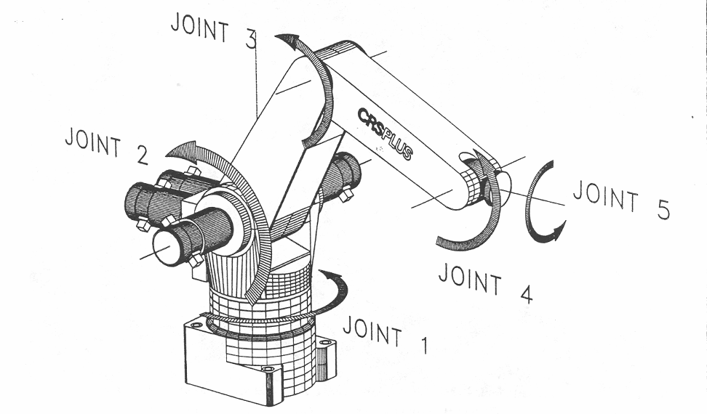
A150 Robotic Arm
link 3
link 2

Slide 17
Kinematics
the study of motion that ignores the forces that cause the motion
  “geometry of motion”
interested in position, velocity, acceleration, etc. of the various links of the manipulator
  e.g., where is the gripper relative to the base of the manipulator? what direction is it pointing in?
  described using rigid transformations of the links

Slide 18
Kinematics
forward kinematics:
  given the link lengths and joint angles compute the position and orientation of the gripper relative to the base
    for a serial manipulator there is only one solution
inverse kinematics:
  given the position (and possibly the orientation) of the gripper and the dimensions of the links, what are the joint variables?
    for a serial manipulator there is often more than one mathematical solution

Slide 19
Wheeled Mobile Robots
robot can have one or more wheels that can provide
  steering (directional control)
  power (exert a force against the ground)
an ideal wheel is
  perfectly round (perimeter 2πr)
  moves in the direction perpendicular to its axis

Slide 20
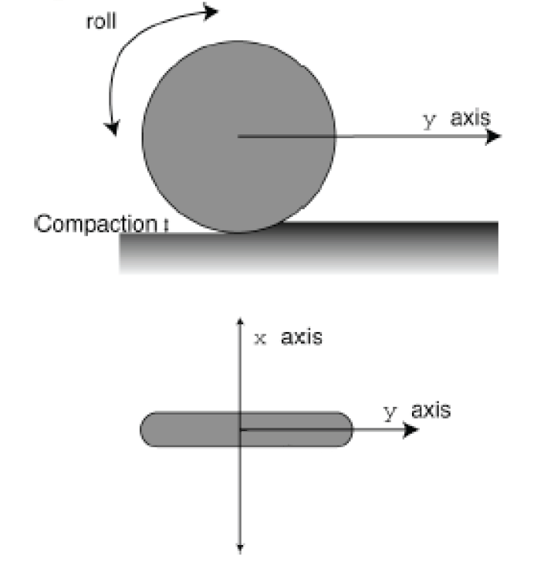
Wheel

Slide 21
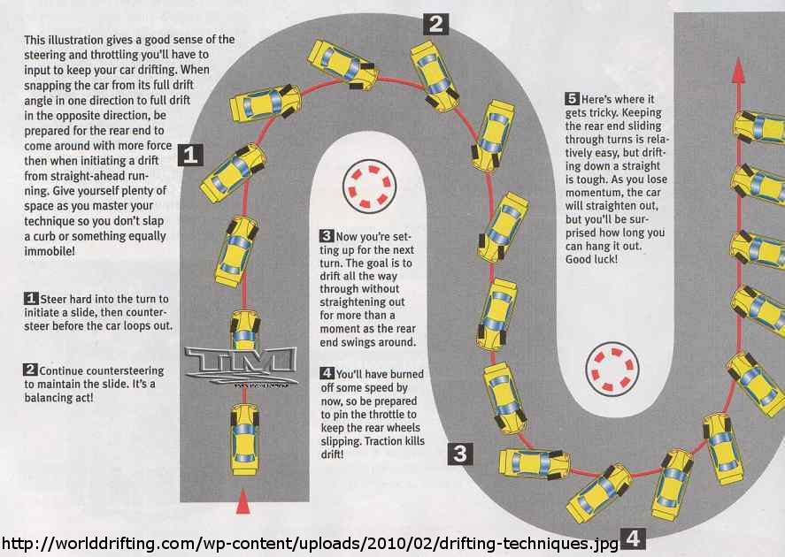
Deviations from Ideal

Slide 22
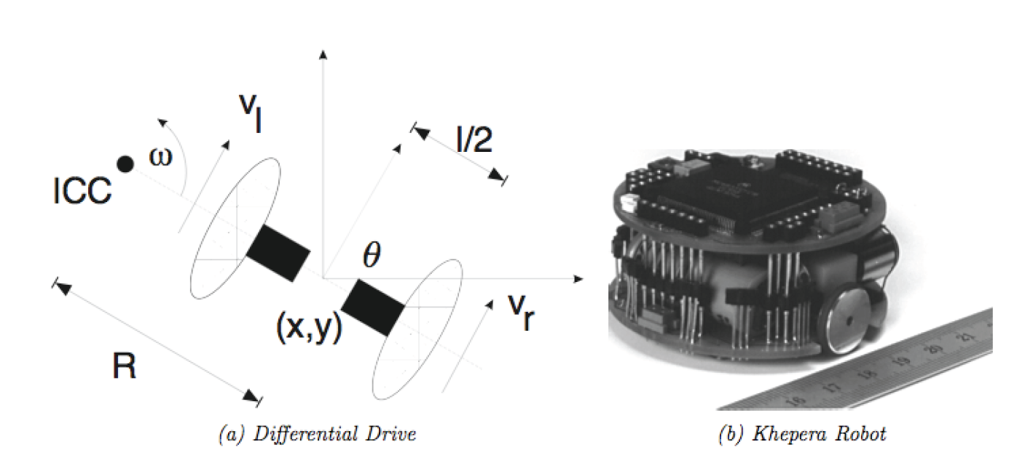
Differential Drive
two independently driven wheels mounted on a common axis

Slide 23
Forward Kinematics
for a robot starting with pose [0 0 0]^{T} moving with velocity V(t) in a direction θ(t) :

Slide 24
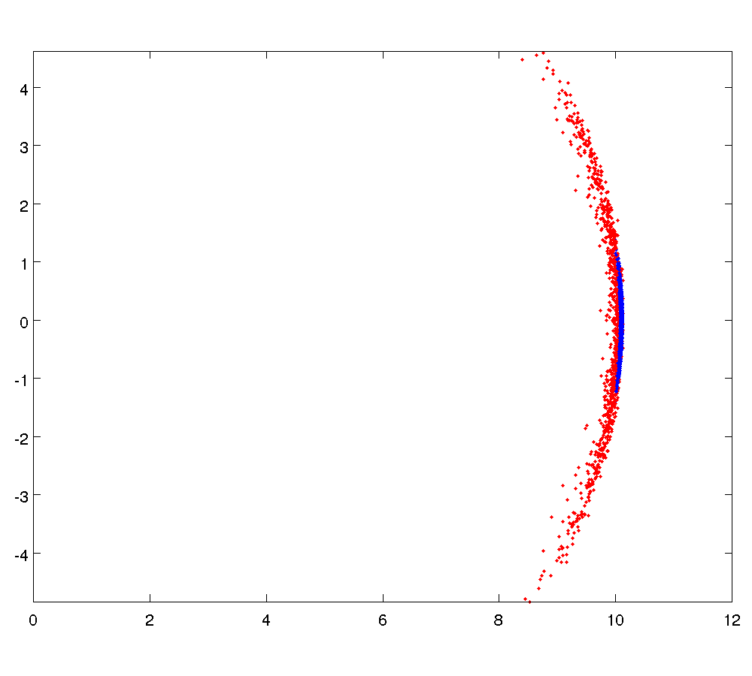
Sensitivity to Wheel Velocity
σ = 0.05
σ = 0.01

Slide 25
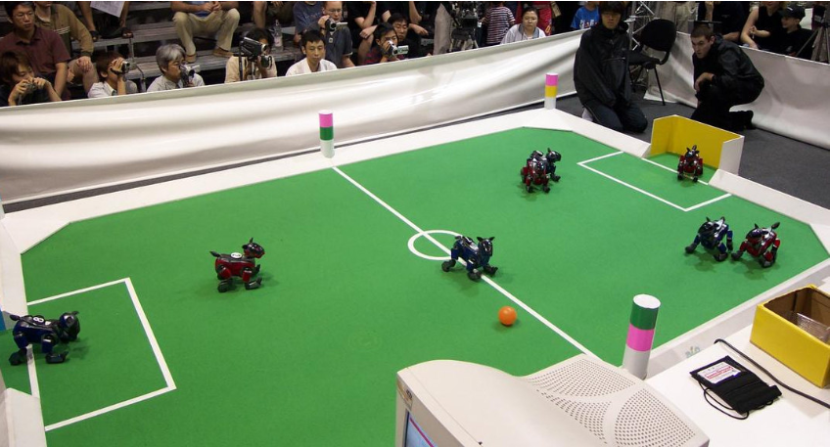
Localization using Landmarks: RoboSoccer

Slide 26
Maps
 |  |  |  |  |  |  |  |  |  |  |  |  |  |  | *
*
goal
start

Slide 27
Path Finding
goal
start

Slide 28
Localization
goal
start

Slide 29
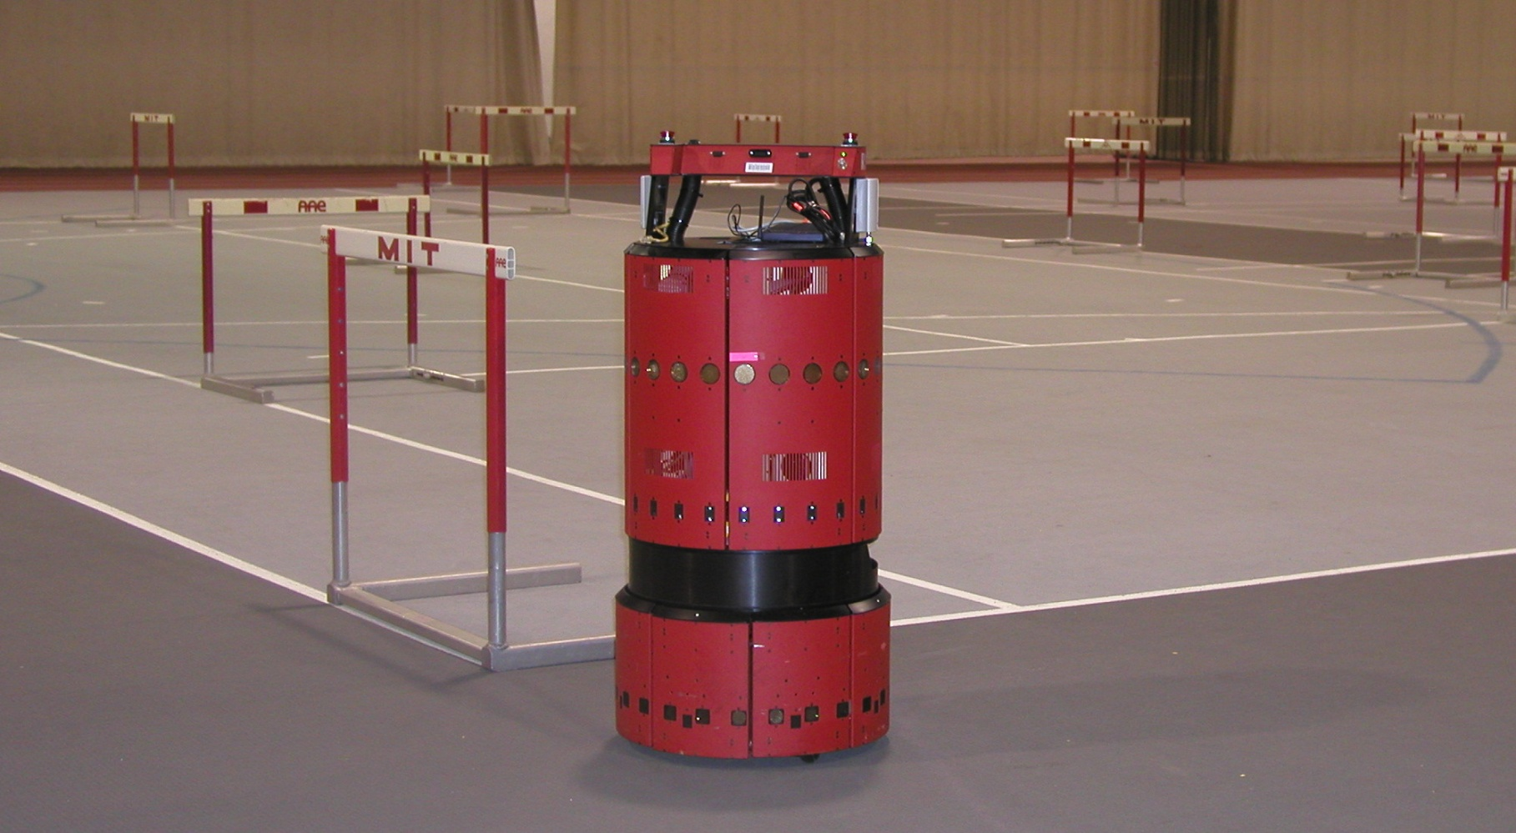
EKF SLAM Application
www.probabilistic-robotics.org
[MIT B21, courtesy by John Leonard]

Slide 30
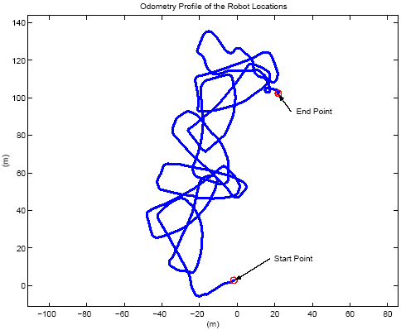
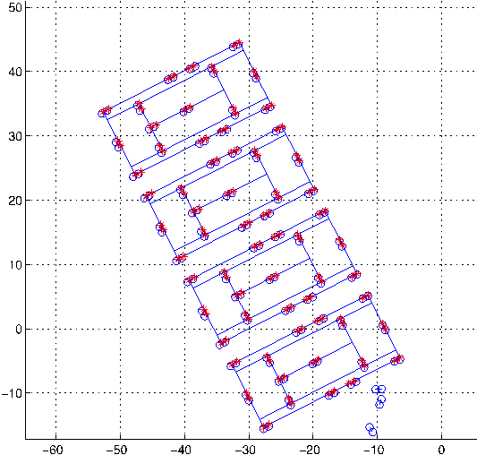
EKF SLAM Application
raw odometry
estimated trajectory
www.probabilistic-robotics.org
[courtesy by John Leonard]

